Slide 1
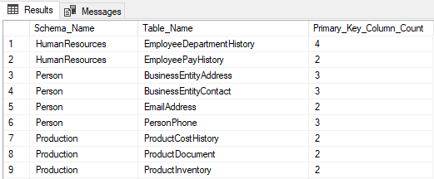
Data Quality
Inconsistencies
Duplicates:
In DBS: Primary Keys
Consistent IDs should be used
Wrong Entries:

Slide 2
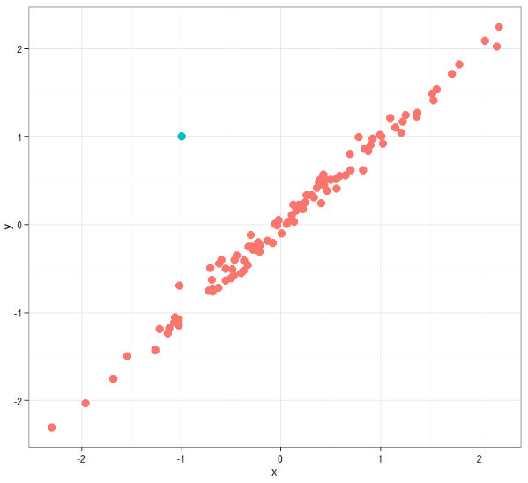
Data Quality
Height = -14.6
Inconsistencies
Wrong Entries:
Duplicates:
In DBS: Primary Keys
Consistent IDs should be used
Impossible Values: -> set to Null for analysis
Outliers -> exclude from analysis NEVER delete original set

Slide 3
Data Quality
5/2/16
Feb 5 2016
02/05/2016
0.00001m 10mm
.42 inch
1.234g
1,234g
10:00:000PM EST
17:00:000 CEST
Inconsistencies
Formats: Time Stamps, Date, Numericals
Scales: (kg, g) (m, mm)
System: (metric, imperial)
Wrong Entries:
Duplicates:
In DBS: Primary Keys
Consistent IDs should be used
Impossible Values: -> set to Null for analysis
Outliers -> exclude from analysis NEVER delete original set

Slide 4


Data Quality
Inconsistencies
Formats: Time Stamps, Date, Numericals
Wrong Entries:
Duplicates:
In DBS: Primary Keys
Consistent IDs should be used
Impossible Values: e.g. negative values for human height -> set to Null
Outliers -> exclude from analysis
Scales: (kg, g) (m, mm)
System: (metric, imperial)
[…] http://edition.cnn.com/TECH/space/9909/30/mars.metric.02/

Slide 5
Data Quality
Inconsistencies
Formats: Time Stamps, Date, Numericals
Wrong Entries:
Duplicates:
In DBS: Primary Keys
Consistent IDs should be used
Impossible Values: -> set to Null for analysis
Scales: (kg, g) (m, mm)
System: (metric, imperial)
Outliers -> exclude from analysis NEVER delete original set

Slide 6
Data Quality @ ChemBioSys
Inconsistencies
Formats: Machine-created Data
Duplicates:
Data Management Platform (SEEK)
ID-consistency in each spreadsheet
Overlooked by each individual scientist
Scales: Machine-created Data
Wrong Entries:
e.g. NMR-Machine,
Mass-Spectrometry, …
System: metric
Impossible values: Machine Errors
Outlier Detection:
Checkup Routine done by individual Scientists

